Slide 1
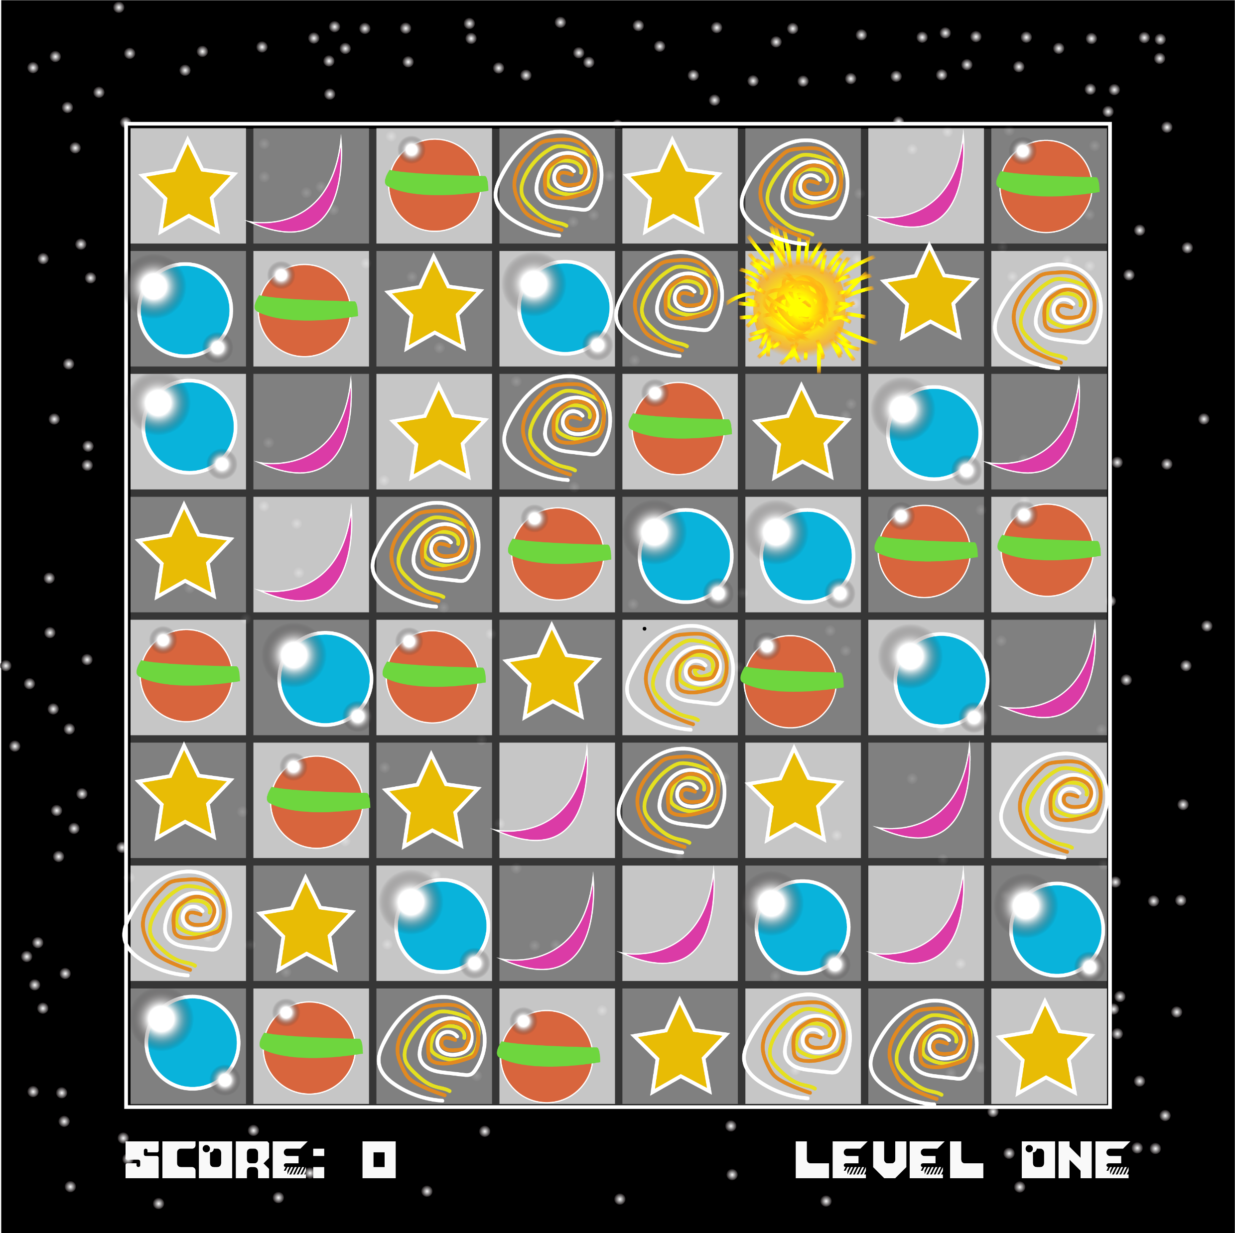
Astro Match
A Match-Three Game

Slide 2
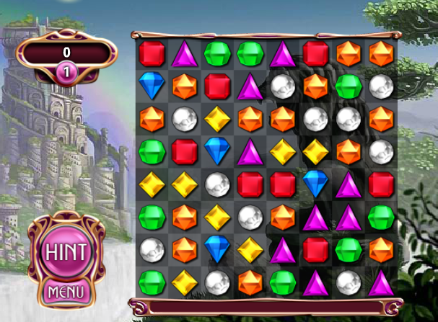
What is it?
5 types of gyms fall to grid
Player must match 3 gems of the same type
Think Bejeweled

Slide 3
Final Product Aim

Slide 4
Features
Multiple levels, become larger as game progresses
Local scoreboard tracking
Can Undo moves (limited, decreases score)
Gameplay affects UI (Screen Shakes, etc.)

Slide 5
Technical Requirements
Score Manager, local score board – Singleton
Undo – Command
UI Screen Effects – Observer
Multiple blocks w/ few Instantiates – Object Pool

